Slide 1
Telecom Churn – Domain Oriented Case Study
Members:
Adith Anish R.M.
Ragini Shriwatri
Subhadip Banerjee

Slide 2
Problem Statement:
Analyze customer-level data of a leading telecom firm, create/build predictive models to identify customers at high risk of churn, and find out the main indicators of churn.

Slide 3
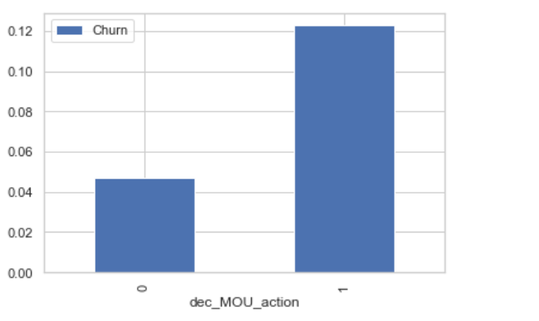
Important features analysis- Churn rate based on whether the Customers whose MoU decreased in the action phase have a higher churn rate than those whose minutes of usage increased in the good phase

Slide 4
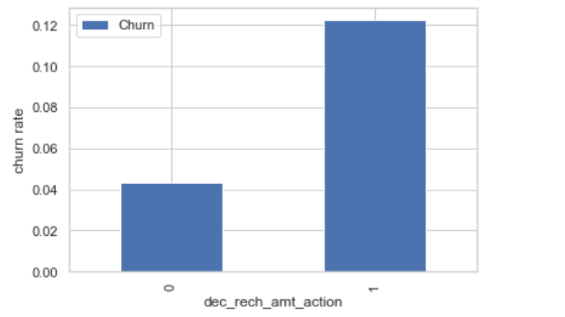
Churn rate on the basis of whether the customer decreased the amount of recharge in the action month

Slide 5
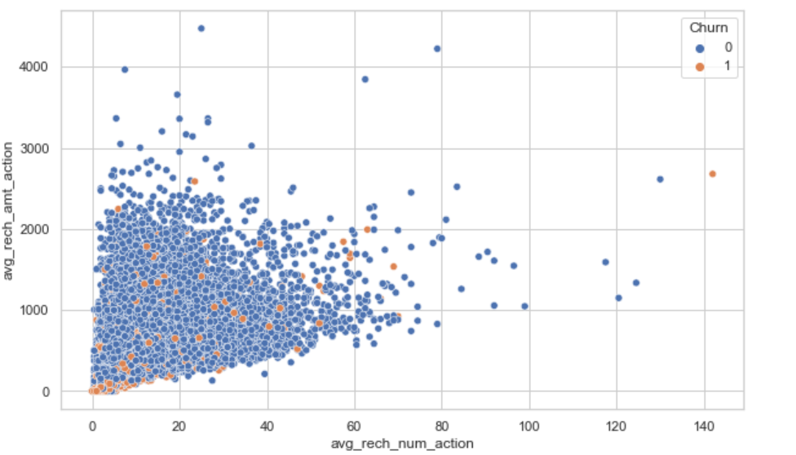
Recharge in action month – here we can see in the pattern, the recharge number and the recharge amount are almost proportional. The higher the number of recharges, the Higher the amount of the recharge

Slide 6
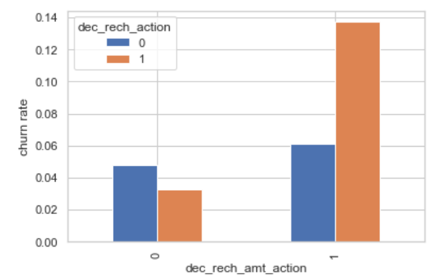
Analyzing amount and recharge in the action month – here we can see in the below plot, that the churn rate is higher for the customers, whose recharge amount as well as the number of recharges have decreased in the action phase when compared to the good phase.

Slide 7
Outcome
From EDA, we observed that there is a considerable drop in recharge, call usage and data usage in the 8th month which is the `Action Phase`.
Average revenue per user in the `7th month` plays a vital role in deciding churn. A sudden drop in it might indicate that the customer might be thinking about churning and appropriate actions should be taken.
Total minutes of usage for outgoing is also an important factor affecting the churn.
Local Minutes of usage (outgoing) are the most affecting features on the customer churn.
Roaming Minutes of usage (incoming & outgoing) are also affecting features on the customer churn.

Slide 8
Strategies to stop customers from churn:
Local Minutes usage drop – this is because of unsatisfactory customer service, poor network or unsuitable customer plans. Efforts shall be made to provide a better network and focus on customer satisfaction.
Based on the network and data usage, last recharge, feedback calls should be made to customer to check where we are lacking and customers expectation and area of improvement so that Appropriate action should be taken to avoid them from churning.
Various attractive offers can be introduced to customers showing a sudden drop in the total amount spent on calls & data recharge in the action phase to lure them.
Customized plans for un satisfied customers to stop them from churning.
Promotional offers/plans can also be very helpful.
Telecom company needs to pay attention to the roaming rates. They need to provide good offers to the customers who are using services from a roaming zone.
The company needs to focus on the STD and ISD rates. Perhaps, the rates are too high. Provide them with some kind of STD and ISD packages.
To look into both of the issues stated above, it is desired that the telecom company collects customer query and complaint data and work on their services according to the needs of customers.

